Slide 1

MyUniv-Training Management System
Submitted By-
Emp ID Team member Name
46292706 Kishandeep Swain
46289314 Priyanka Priyadarshini
46283127 Sipra Subhadarsini Biswal
46289246 Sonali Dalai
46284372 Purnashree Parikhita Pani
46283110 Lipsarani Sutar
Guided By-
Shailaja Patil

Slide 2
CONTENTS
AIM OF THE PROJECT
REQUIRMENT
DESIGN
MEMBER CHALLENGE
IMPLEMENTATION SCREEN
DISPLAYING USERS SIGNED IN TO THE SYSTEM
FUTURE SCOPE
CONCLUSION

Slide 3

AIM OF THE PROJECT
Training management system is a software where users can login and learn
from training programs.He can enroll to courses ,learn and complete
the courses.
Admin should be able to login and manage all functionality.
User should be able to Register/login and browse through catalog.

Slide 4
REQUIREMENTS
Technical Requirements –
C programming language
File input/output operations to read and write data.
Multiple Linked Lists to read data from files at the beginning
and write updated data to files before applicaton ends.
Dynamic memory allocation.
Software Requirement--
Vi Editor, ctags, splint, valgrind, gcc, make, github account

Slide 5
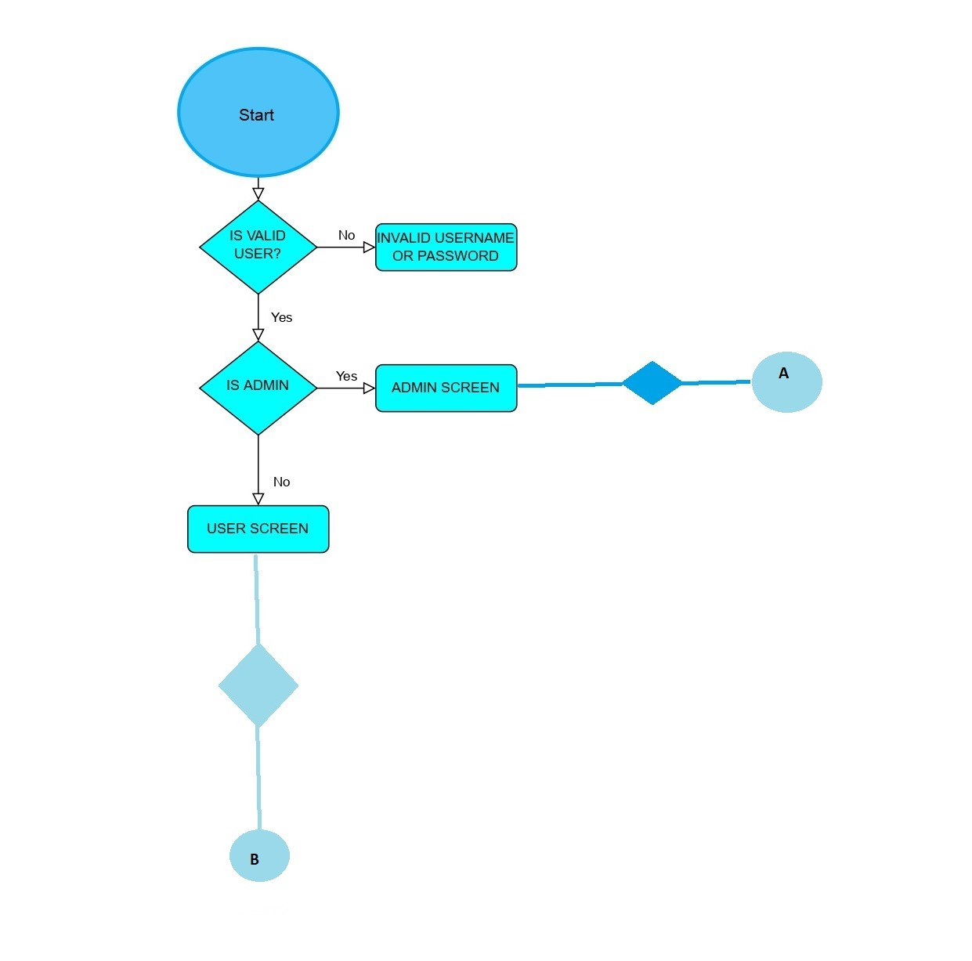
FLOW CHART FOR LOGIN SCREEN

Slide 6
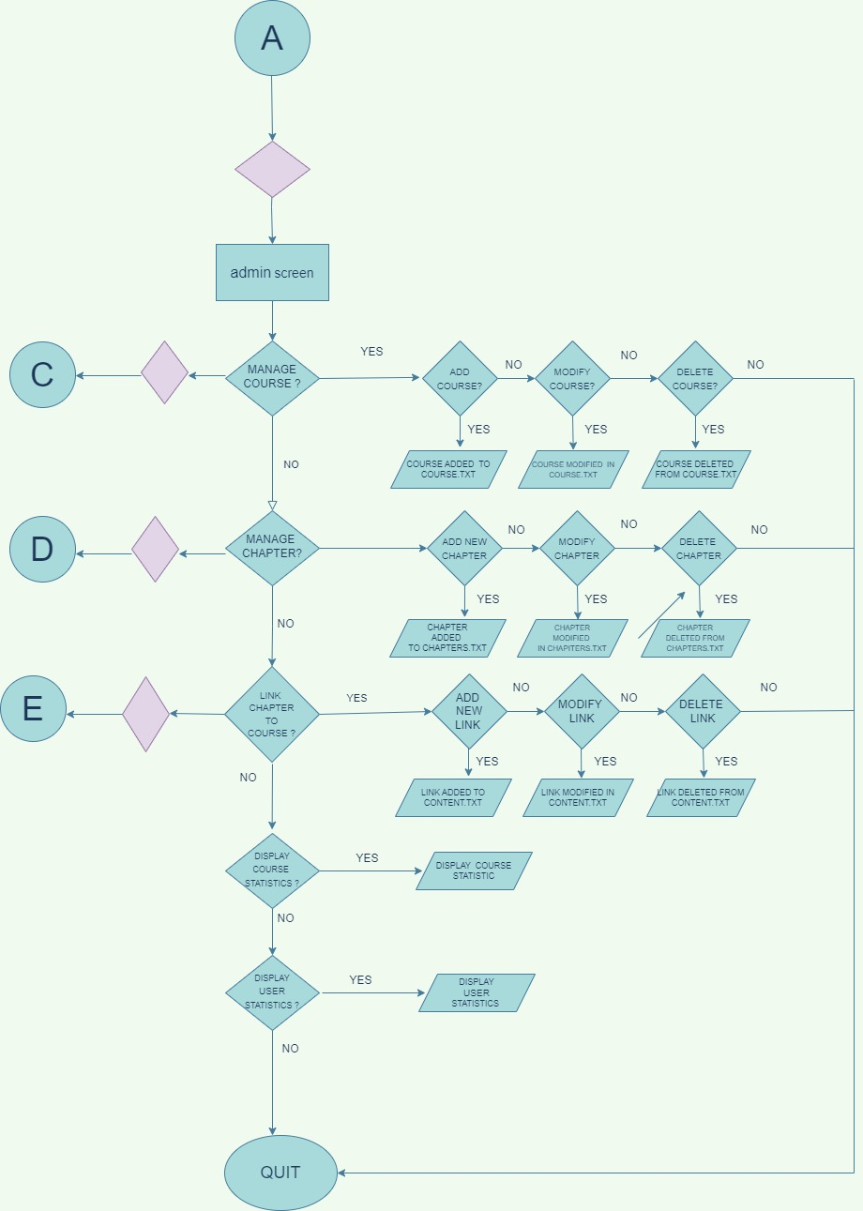
FLOW CHART FOR ADMIN SCREEN

Slide 7
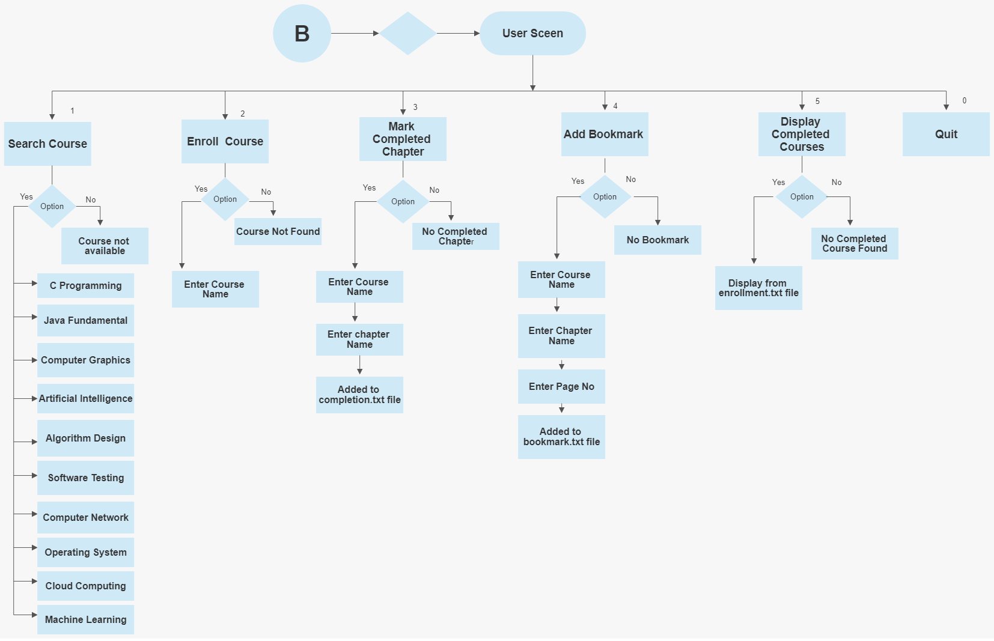
FLOW CHART FOR USER SCREEN

Slide 8
MEMBERS CHALLENGE
Kishandeep Swain : Story Board,MOM,Level-1 DFD,Coding Execution,Schedule Plan,Valgrind,Makefile
Priyanka Priyadarshini :Design documentation with flowcharts , SRS part also , Code execution , UT IT Testcase
Sipra Subhadarsini: UT-IT test plan , Coding part ,Schedule updation on time, Code checklist review , flowchart review.
Sonali Dalai: RTM,Flow Chart,Design ,Coding Part,Code Review Checklist
Purnashree Parikhita Pani: UT IT Testcases,Flow Chart,Coding Part,Presentation
Lipsarani Sutar:DFD Context Diagram,Flow Chart,Inspection Log,Presentation,Designing Layout,Coding Part

Slide 9
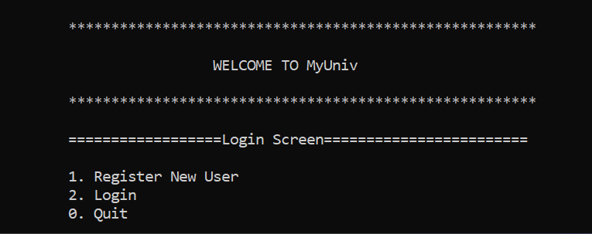
IMPLEMENTATION SCREEN
Login Screen

Slide 10
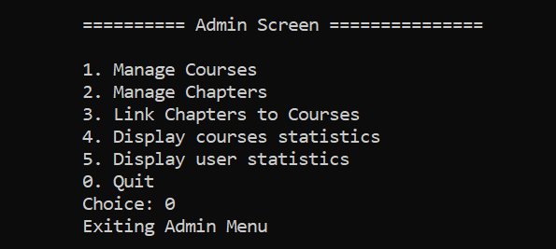
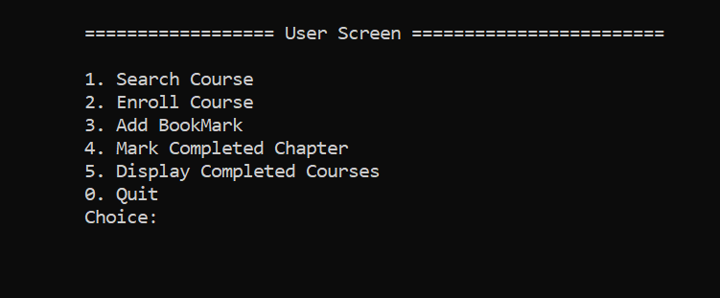
IMPLEMENTATION SCREEN
ADMIN SCREEN USER SCREEN

Slide 11
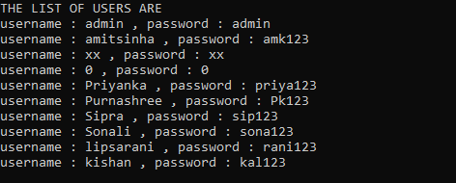
DISPLAYING USERS SIGNED IN TO THE SYSTEM

Slide 12
FUTURE SCOPE
We can add paid courses and implement payment methods for user.We can add live interview sessions.We can add video lectures and we can add mock test of each courses.We can also add feature of generation of certificate after completion of course.MyUniv can be used learning module interface for all type of education.We can add calender features and also evaluate the courses.

Slide 13
CONCLUSION
Training Management System is renowned software that offers a unique and best platform to manage learning resources and contents.
It helps the organization,admin and user to collaborate and handle all the resources used this training process.
It helps them to create,deliver and track several training contents.

Slide 14
THANK YOU

